Slide 1

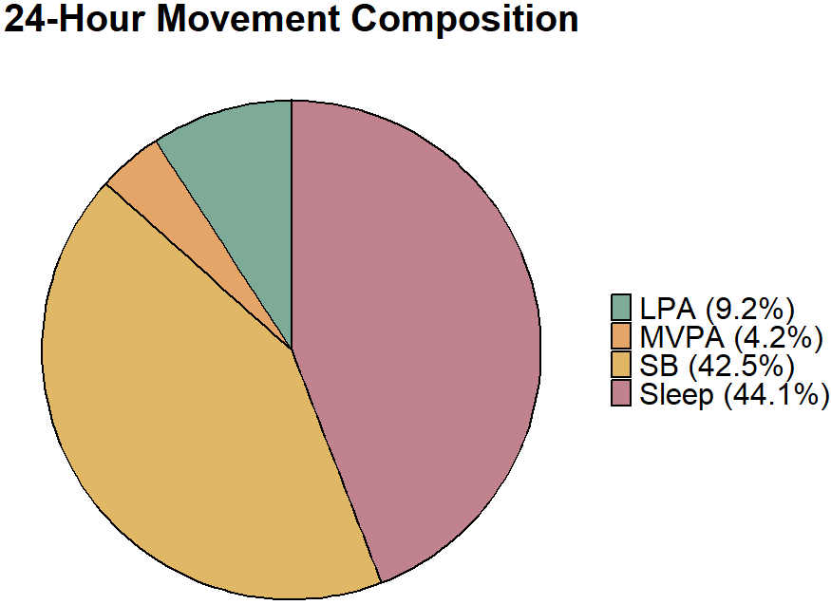




Exploring associations between 24-hour movement behavior compositions and academic performance in college students
Purpose
Examine how the 24-hour movement composition (sleep, SB, LPA, MVPA) relates to college GPA using a compositional approach.
Method
Sample: 150 college students (Mage = 19.2 ± 1.42 years; 70.7% female; 44.7% Hispanic)
Design: cross-sectional
Measures:
  Movement behaviors: Wrist-worn ActiGraph GT3X+, 7 full days
  Academic performance: Cumulative GPA (university records)
  Covariates: SAT, gender, age, race/ethnicity, health status, year in school
Data analysis: Compositional linear regression & isotemporal substitution
Results
Overall movement composition was significantly associated with GPA
  ↑ SB & ↑ MVPA associated with ↑ GPA
  ↑ LPA associated with ↓ GPA
  Sleep not associated with GPA
Reallocating time from LPA → sleep, SB, or MVPA
may improve academic performance
Sleep
MVPA
LPA
SB
Less time
More time
Holesovsky, C.D., Minnigh, T.L., Coyle, T.R., & Brown, D.M.Y. (2026). Exploring associations between 24-hour movement behavior compositions and academic performance in college students. Current Issues in Sport Science (CISS)Science. https://doi.org/10.36950/2026.11ciss002

